Slide 1

MEAN Stack
GROUP 02:
HỒ LÊ THÔNG 17110077
LÊ CHÍ THÔNG 17110078
ĐỖ NGUYỄN HOÀNG HẢI 17110024
LA QUANG HUY 18110017

Slide 2
Contents of this topic
MEAN Stack overview
Components of MEAN Stack:
MongoDB
Express.js
AngularJS
Node.js
Demonstration

Slide 3
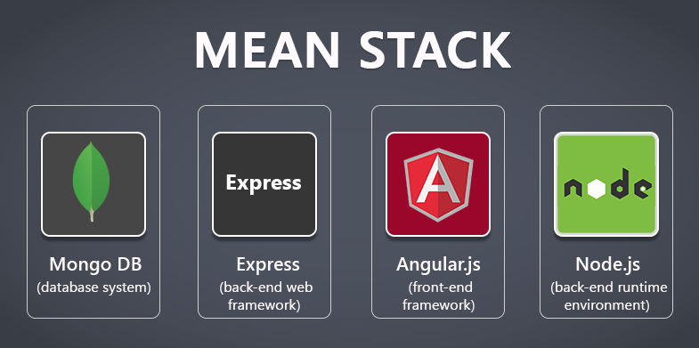
What is MEAN?
Mean Stack is a combination of MongoDB, ExpressJS, AngularJS, NodeJS.
MEAN is a free and open-source JavaScript software stack for building dynamic web sites and web applications.
Notes:
Because all components of the MEAN stack support programs that are written in JavaScript, MEAN applications can be written in one language for both server-side and client-side execution environments.
Though often compared directly to other popular web development stacks such as the LAMP stack, the components of the MEAN stack are higher-level including a web application presentation layer and not including an operating system layer.

Slide 4
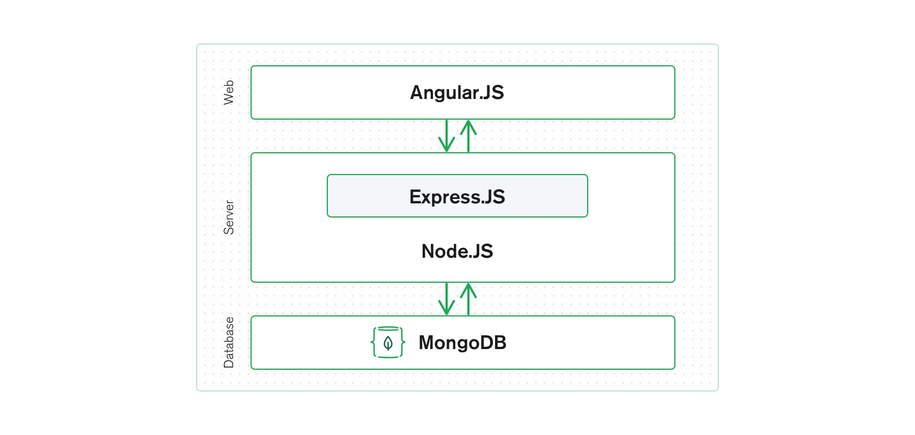
MEAN Stack Architecture

Slide 5
Why MEAN stack is popular?
Effortless Swapping between Client and Server
Developers benefit a lot from using MEAN Stack since they build web applications with only a single language.
Simple Solution
MEAN Stack enables developers to create a simple and open-source solution.
Open Source Components
The components in MEAN Stack are open source.
Cost-Effective
MEAN Stack is lucrative for businesses.
Timer-Saving and Resourceful Tool
One of MEAN Stack’s major features is the enormous directory of modules libraries in Node.js.
Notes:
Effortless Swapping between Client and Server: Developers benefit a lot from using MEAN Stack since they build web applications with only a single language. A JS specialist can execute projects with the MEAN Stack formula application. MEAN Stack allows developers to deploy web applications immediately on a server.
Simple Solution: MEAN Stack enables developers to create a simple and open-source solution. Developers need to know only one programming language, which is JavaScript.
Open Source Components: The components in MEAN Stack are open source. The components in MEAN Stack are open source. The components are available for free for developers to build robust solutions and applications.
Cost-Effective: MEAN Stack is lucrative for businesses. The components are all open-sourced and free. Companies only need to invest in a full-stack JavaScript developer.
Timer-Saving and Resourceful Tool: One of MEAN Stack’s major features is the enormous directory of modules libraries in Node.js. It prevents developers to create modules from scratch. Developers also receive notification from the automatic testing feature. The feature helps in case there are any errors for developers to rectify in time.

Slide 6
Why MEAN stack is popular?
Programming Language
JavaScript is the programming language in MEAN Stack.
Maximum Flexibility
MEAN Stack is highly flexible during web application development.
Compatible with Cloud
MongoDB in MEAN Stack makes it highly compatible with the cloud. It helps execute cloud features with the MongoDB solution.
JavaScript Object Notation
JavaScript Object Notation or JSON is a fine format that stores and transfers data. MEAN Stack components AngularJS and NodeJS, both use JSON.
Worldwide Community Support
JavaScript is a universal programming language. Hence developing communities all across the globe that provide constant support from experts and leaders.
Notes:
Programming Language: JavaScript is the programming language in MEAN Stack. Developers comfortable with the language can easily adapt to new projects and schedules. As the web application develops it is easy to update and add features. It is a scalable programming language and benefits during deployment.
Maximum Flexibility: MEAN Stack is highly flexible during web application development. It is easy and quick to add new aspects while developing or post-development.
Compatible with Cloud: MongoDB in MEAN Stack makes it highly compatible with the cloud. It helps execute cloud features with the MongoDB solution. Easier developing, testing, and deploying phases of the application with MEAN Stack.
JavaScript Object Notation: JavaScript Object Notation or JSON is a fine format that stores and transfers data. MEAN Stack components AngularJS and NodeJS, both use JSON. Even MongoDB utilizes JSON Format while storing data. MEAN Stack and businesses benefit from this while developing the web application. There is no requirement to reformat the data and is pivotal support for larger projects.
Worldwide Community Support: JavaScript is a universal programming language. Hence developing communities all across the globe that provide constant support from experts and leaders. MEAN Stack provides modern features in web development applications. For example, traditional web applications would require refreshing the web page. MEAN Stack heavily uses single-page applications which reduce refreshing web pages. Hence making it more popular among businesses and developers.

Slide 7
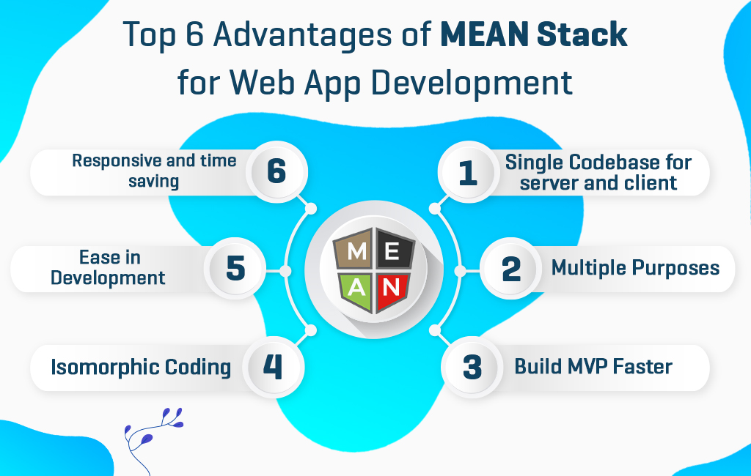

Slide 8
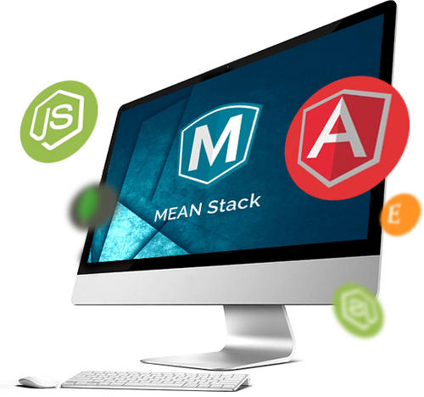
Some key use cases for MEAN stack

Slide 9
Use cases for MEAN stack
MEAN Stack is a strong choice for developing cloud native applications because of its scalability and its ability to manage concurrent users.
The AngularJS frontend framework also makes it ideal for developing single-page applications (SPAs) that serve all information and functionality on a single page.
Here are a few examples for using MEAN:
Calendars
Expense tracking
News aggregation sites
Mapping and location finding

Slide 10
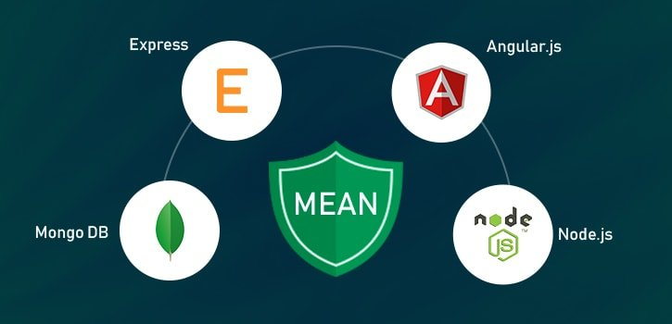
Components of MEAN Stack

Slide 11

01
MongoDB

Slide 12

What is MongoDB?
Definition of MongoDB

Slide 13

Install MongoDB on Windows
Download MongoDB from the link below: https://www.mongodb.org/downloads
Run the downloaded file
After running the file, go to the directory C:\Program Files\MongoDB\Server\3.4\bin , run the file mongod to start mongoDB
Use address 127.0.0.1:27017 to make connection to mongoDB

Slide 14
Some features of MongoDB
Ad-hoc query
Indexing
Replication
Aggregation
File Storing

Slide 15
When we need MongoDB?
Manage and Deliver the content
Mobile and Social
Manage Customer’s Database

Slide 16
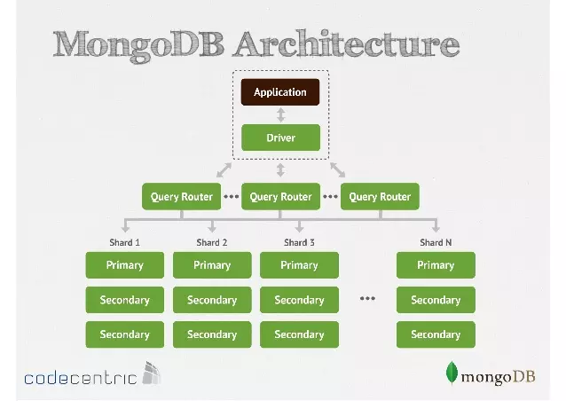
How MongoDB work?

Slide 17
Disadvantages of MongoDB
Take RAM as the focus of operation
Possibility of data loss from unexpected power failure
There is no transaction mechanism for servicing banking applications.
Unable to apply transaction models that require high accuracy due to no constraints.

Slide 18
Advantages of MongoDB
Feature
Performance
Unstructured data storage, no constraints, integrity should be high availability, great performance and easy to expand storage.
Data is cached on RAM, limited access to the hard drive, so read and write speeds are high.

Slide 19
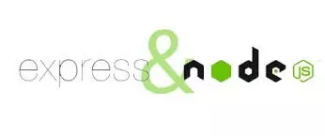
02
ExpressJs
Fast, unopinionated, minimalist web framework for Node.js

Slide 20
What is ExpressJS?
Express.js is a back end web application framework for Node.js,
It is designed for building web applications and APIs

Slide 21
How to install ExpressJS
To install ExpressJs you need these things:
Install NodeJS. -> Here
Install NPM. -> Here
After we installed Nodejs and NPM then we move to -> Here

Slide 22
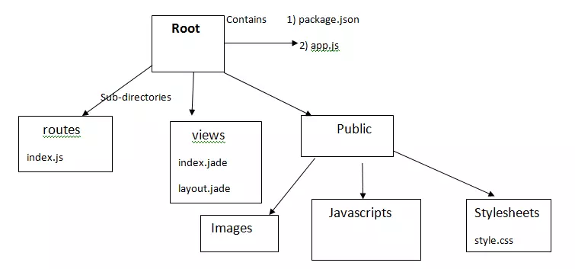
ExpressJs Architecture

Slide 23
Some Feature of ExpressJs
Server development
Middleware
Routing
Templating
Debugging

Slide 24
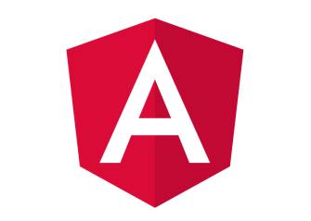
Angular

Slide 25
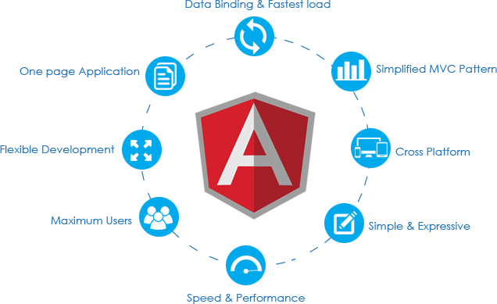
Basics of an Angular Application
Angular application is still a Single-Page Application (SPA), and thus its loading is triggered by a main request to the server. When we open any URL in our browser, the very first request is made to our server.

Slide 26
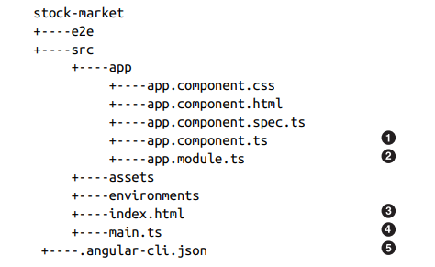
the structure of Angular CLI
Notes:
Root component
Main module
Root HTML
Entry point
Angular CLI config

Slide 27
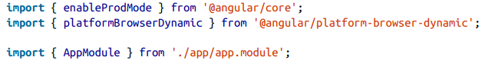
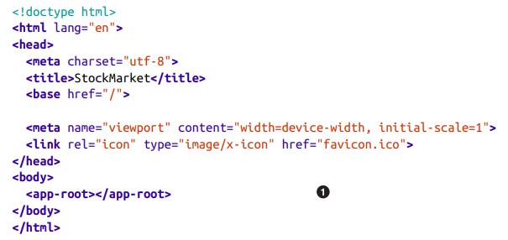
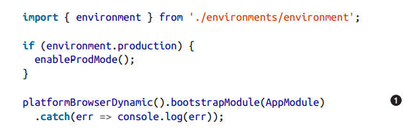
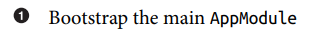
The Entry Point—main.ts
Root HTML—index.html
Notes:
The important part of our bootstrapping piece is the main.ts file. The main.ts file, on the other hand, identifies which Angular module is to be loaded when the application starts. It can also change application-level configuration
The only thing of note in the preceding code is the <app-root> element in the HTML, which is the marker for loading our application code

Slide 28
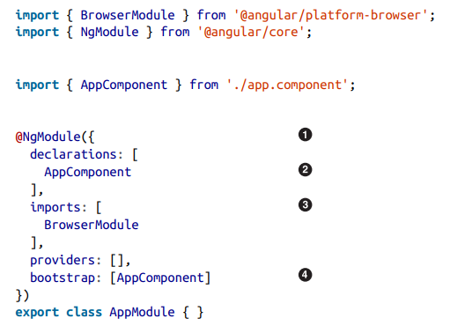
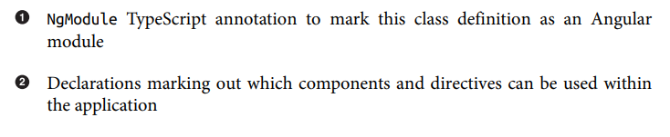
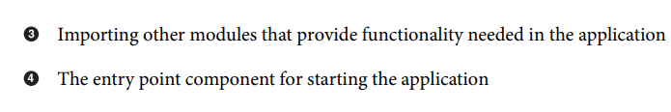
Main Module—app.module.ts
Notes:
The application module file can be thought of as the core configuration of your application, from loading all the relevant and necessary dependencies, declaring which components will be used within your application, to marking which is the main entry point component of your application:

Slide 29
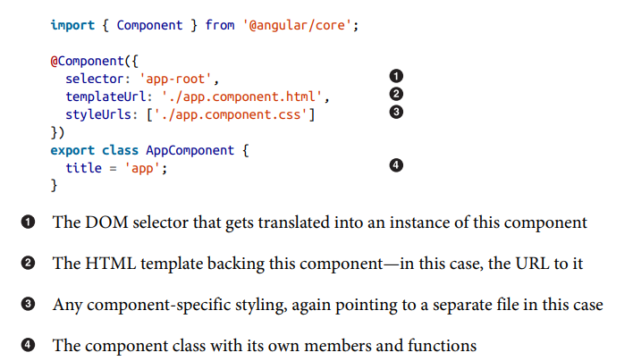
Root Component—AppComponent
Notes:
The component class itself finally encapsulates all the functionality backing your component. It makes it easy to think of the responsibilities of the component class as twofold:
• Load and hold all the data necessary for rendering the component
• Handle and process any events that may arise from any element in the component

Slide 30
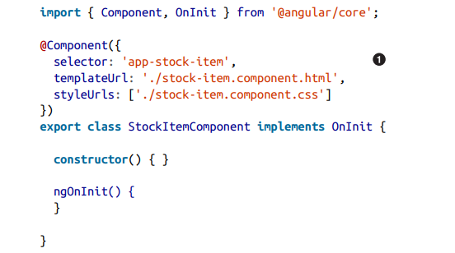
Using New Component
Take a look at the generated stock-item.component.ts file:
Notes:
The component has no data and does not provide any functionality at this point; it simply renders the template associated with it. The template at this point is also triv‐ ial, and just prints out a static message. To use this component in our application, we can simply create an element that matches the selector defined anywhere inside our main app component. If we had more components and a deeper hierarchy of components, we could choose to use it in any of their templates as well

Slide 31
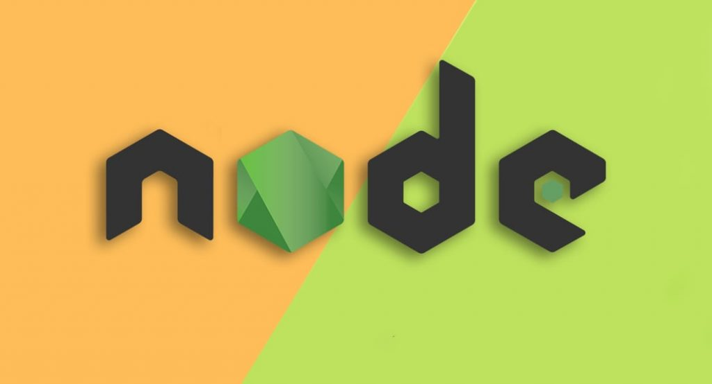
NODEJS

Slide 32
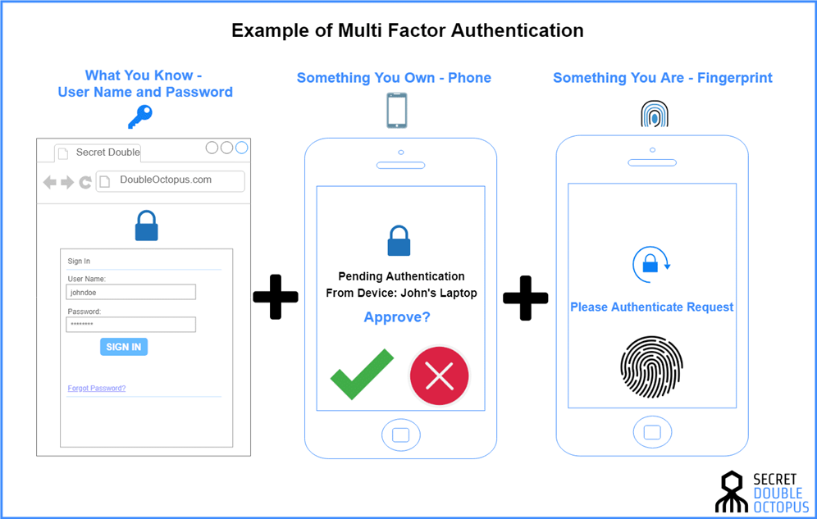
Node authentication
Notes:
Authentication of the client is the first step before starting any Application. The basic authentication in the Node.js application can be done with the help express.js framework. Express.js framework is mainly used in Node.js application because of its help in handling and routing different types of requests and responses made by the client using different Middleware.

Slide 33
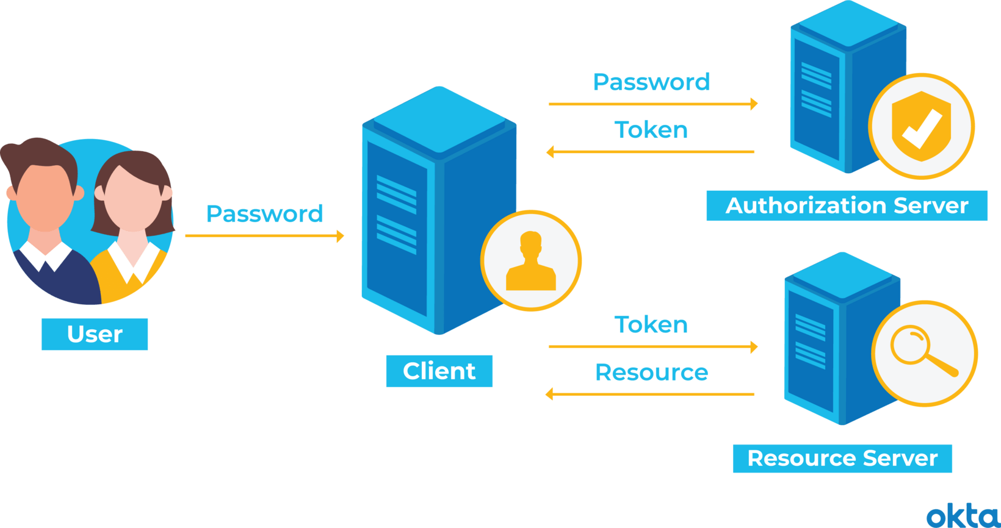
token based authentication
Notes:
The main benefits of tokens are:
Stateless and scalable servers
Mobile application ready
Pass authentication to other applications (think OAuth through Facebook third-party applications)
Extra security as compared to other authentication methods

Slide 34
Server Based Authentication (Traditional Method)

Slide 35
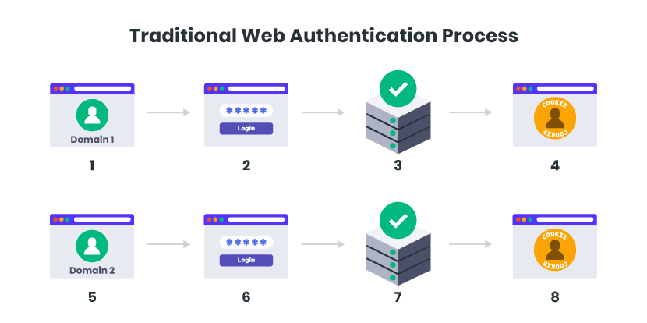
Server Based Authentication (Traditional Method)
HTTP protocol is stateless, if we authenticate a user with a username and password, then on the next request, our application won’t know who we are.
We would have to authenticate again
Problem:
Session
Scalability
CORS
CSRF- cross-site request forgery
Notes:
Sessions: Every time a user is authenticated, the server will need to create a record somewhere
on our server. This is usually done in memory and when there are many users authenticating, the
overhead on your server increases.
Scalability: Since sessions are stored in memory, this provides problems with scalability. As our
cloud providers start replicating servers to handle application load, having vital information in
session memory will limit our ability to scale.
CORS: As we want to expand our application to let our data be used across multiple mobile
devices, we have to worry about cross-origin resource sharing (CORS). When using AJAX calls
to grab resources from another domain (mobile to our API server), we could run into problems with forbidden requests.
CSRF: We will also have protection against cross-site request forgery- gia mao (CSRF). Users are susceptible
to CSRF attacks since they can already be authenticated with say a banking site and this could be taken advantage of when visiting other sites

Slide 36
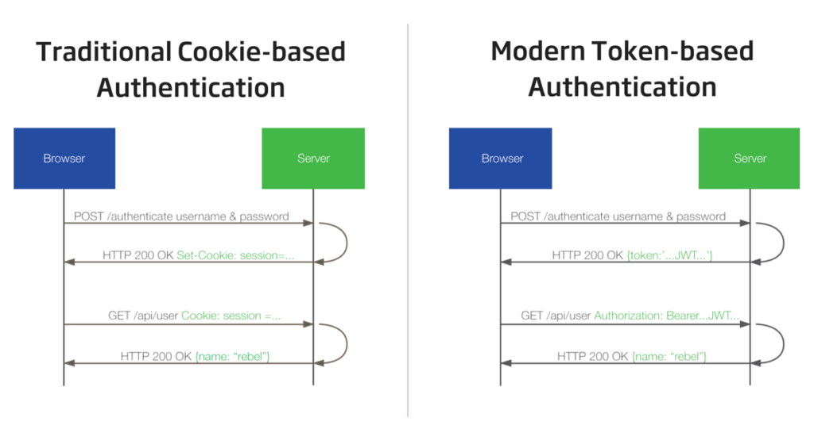
Token Based Authentication Works
Token based authentication is stateless. Not storing any information about our user on the server or in a session.
Notes:
No session information means your application can scale and add more machines as necessary without worrying about where a user is logged in.
➔ Every single request after the first will require the token. This token should be sent in the HTTP header so that we keep with the idea of stateless HTTP requests.

Slide 37
Token Based Authentication Works
1. User Requests Access with Username / Password
2. Application validates credentials
3. Application provides a signed token to the client
4. Client stores that token and sends it along with every request
5. Server verifies token and responds with data

Slide 38
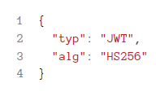
JSON Web Tokens (JWT)
JWT look like
Header. payload. Signature
Header
The header carries 2 parts:
declaring the type, which is JWT
the hashing algorithm to use (HMAC SHA256 in this case)

Slide 39
Payload
iss: The issuer of the token
• sub: The subject of the token
• aud: The audience of the token
• exp…
Put the information that we want to transmit as well as other information about our token.
There are multiple claims that we can provide:
registered claim names
public claim names
private claim names
These are the claims that we create ourselves like user name, information, and other important
information.
A producer and consumer may agree to use claim names that are private. These are subject to
collision, so use them with caution

Slide 40
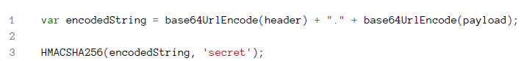
Signature
Signature is made up of a hash of the following components:
the header
the payload
secret
The token is sent on every request so there are no CSRF attacks
full JSON Web Token

Slide 41


